Slide 1
Data and sampling Distributions
Dr. Latesh Malik
BE, MTech, PhD (Computer Science)
Associate Professor, Department of Computer Engineering
Govt Engineering College , Nagpur

Slide 2
Probability
-Probability
-Random Variables
-probability distribution
-discrete probability distributions ::binomial, multimodal and Poisson
-continuous probability distributions ::normal, chi-squared, student’s t and Ftest

Slide 3
Probability & Statistics
-Probability caters uncertainty and randomness in processes.
-Probability helps us make a judgement about future events based on previous event data.
-Probability is the chance of an outcome in an experiment
-Statistics helps us infer population based on random samples
Statistics can answer the following questions:
S1: A random samples of five balls is selected from a bag and two red and three white balls are picked. What is the total population of red and white balls?

Slide 4
Random Variables
-A random variable stores the output of a random event.
-Random variables are used to quantify the outcomes of random occurrences
Example, a random variable can store the side of a flipped coin, as head (0) or tail (1).

Slide 5
Probability Distribution
A probability distribution is a list of all of the possible outcomes of a random variable, along with their corresponding probability values.
For example, the probability distribution of a six-sided dice roll
Outcome of dice roll | 1 | 2 | 3 | 4 | 5 | 6
Probability | 1/6 | 1/6 | 1/6 | 1/6 | 1/6 | 1/6

Slide 6
Discrete vs continuous variables
If a variable can take any specified value, then it is called a discrete variable. For example, you throw a dice (the specified values will be 1, 2, 3, 4, 5 or 6) or toss a coin (the specified values will be head or tail).
If a variable can take a specified range of values and all the values in between (continuous), then it is a continuous variable. For example, measuring height in centimetres, where the values can be 150 cm, 150.5 cm, 150.6 cm, and so on. Generally, real-time values are stored in continuous variables.

Slide 7
Discrete: Binomial probability distribution
A binomial random variable contains a number of successes in n repeated trials of an event. Each event trial has two possible outcomes (success or failure).
Binomial probability distribution is the distribution of the probability of a binomial random variable. It allows you to perform n trials, where the outcome of each trial is success or failure
b(x; n, P) = { n! / [ x! (n - x)! ] } * P^{x} * (1 - P)^{n – x}

Slide 8
Binomial Probability Distribution
Number of trials (n) = 15
Number of successes (x) = 5
Probability of success (P) in each trial = 1/4 = 0.25
We can use the dbinom(x,n,P) function in R:
> dbinom(5, size=15, prob=0.25)
[1] 0.165146

Slide 9
Binomial Settings and Binomial Random Variables
A binomial setting arises when we perform n independent trials of the same chance process and count the number of times that a particular outcome (called a “success”) occurs.
The four conditions for a binomial setting are
Binary? The possible outcomes of each trial can be classified as “success” or “failure.”
Independent? Trials must be independent. That is, knowing the outcome of one trial must not tell us anything about the outcome of any other trial.
Number? The number of trials n of the chance process must be fixed in advance.
Same probability? There is the same probability of success p on each trial.

Slide 10
Binomial Settings and Binomial Random Variables
Problem: Determine whether the given scenario describes a binomial setting. Justify your answer.
(a) Genetics says that the genes children receive from their parents are independent from one child to another. Each child of a particular set of parents has probability 0.25 of having type O blood. Suppose these parents have 5 children. Count the number of children with type O blood.

Slide 11
Binomial Settings and Binomial Random Variables
Problem: Determine whether the given scenario describes a binomial
setting. Justify your answer.
(a) Genetics says that the genes children receive from their parents are independent from one child to another. Each child of a particular set of parents has probability 0.25 of having type O blood. Suppose these parents have 5 children. Count the number of children with type O blood.
(a)
Binary? “Success” 5 has type O blood. “Failure” 5 doesn’t have type O blood.
Independent? Knowing one child’s blood type tells you nothing about another child’s because they inherit genes independently from their parents.
Number? n = 5
Same probability? p = 0.25
This is a binomial setting.

Slide 12
Binomial Settings and Binomial Random Variables
Problem: Determine whether the given scenario describes a binomial
setting. Justify your answer.
(b) Shuffle a standard deck of 52 playing cards. Turn over the first 10 cards, one at a time. Record the number of aces you observe.

Slide 13
Binomial Settings and Binomial Random Variables
Problem: Determine whether the given scenario describes a binomial
setting. Justify your answer.
(b) Shuffle a standard deck of 52 playing cards. Turn over the first 10 cards, one at a time. Record the number of aces you observe.
(b)
Binary? “Success” 5 get an ace. “Failure” 5 don’t get an ace.
Independent? No. If the first card you turn over is an ace, then the next card is less likely to be an ace because you’re not replacing the top card in the deck. If the first card isn’t an ace, the second card is more likely to be an ace.
This is not a binomial setting because the independent condition is not met.

Slide 14
Binomial Settings and Binomial Random Variables
Problem: Determine whether the given scenario describes a binomial
setting. Justify your answer.
(c) Shuffle a deck of cards. Turn over the top card. Put the card back in the deck, and shuffle again. Repeat this process until you get an ace. Count the number of cards you had to turn over.

Slide 15
Binomial Settings and Binomial Random Variables
Problem: Determine whether the given scenario describes a binomial
setting. Justify your answer.
(c) Shuffle a deck of cards. Turn over the top card. Put the card back in the deck, and shuffle again. Repeat this process until you get an ace. Count the number of cards you had to turn over.
(c)
Binary? “Success” 5 get an ace. “Failure” 5 don’t get an ace.
Independent? Yes. Because you are replacing the card in the deck and shuffling each time, the result of one trial doesn’t tell you anything about the outcome of any other trial.
Number? No. The number of trials is not fixed in advance.
Because there is no fixed number of trials, this is not a binomial setting.

Slide 16
Binomial Settings and Binomial Random Variables
The blood type scenario in part (a) of the example is a binomial setting. If we let X = the number of children with type O blood, then X is a binomial random variable.

Slide 17
Binomial Settings and Binomial Random Variables
The blood type scenario in part (a) of the example is a binomial setting. If we let X = the number of children with type O blood, then X is a binomial random variable.
The probability distribution of X is called a binomial distribution.

Slide 18
Binomial Settings and Binomial Random Variables
The blood type scenario in part (a) of the example is a binomial setting. If we let X = the number of children with type O blood, then X is a binomial random variable.
The probability distribution of X is called a binomial distribution.
The count of successes X in a binomial setting is a binomial random variable.
The possible values of X are 0, 1, 2, …, n.
The probability distribution of X is a binomial distribution. Any binomial distribution is completely specified by two numbers: the number of trials n of the chance process and the probability p of success on each trial.

Slide 19
Calculating Binomial Probabilities
Each child of a particular set of parents has probability 0.25 of having type O blood. Suppose these parents have 5 children.

Slide 20
Calculating Binomial Probabilities
Each child of a particular set of parents has probability 0.25 of having type O blood. Suppose these parents have 5 children.
What’s the probability that exactly one of the five children has type O blood?

Slide 21
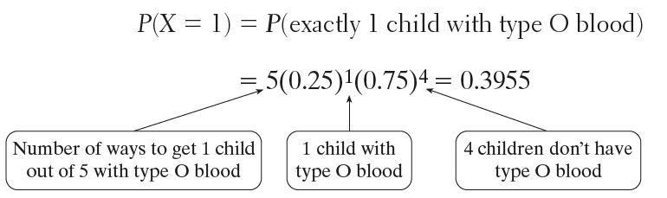
Calculating Binomial Probabilities
Each child of a particular set of parents has probability 0.25 of having type O blood. Suppose these parents have 5 children.
What’s the probability that exactly one of the five children has type O blood?

Slide 22
Calculating Binomial Probabilities
Each child of a particular set of parents has probability 0.25 of having type O blood. Suppose these parents have 5 children.
What’s the probability that exactly one of the five children has type O blood?
P(X = k) = (# of ways to get k successes in n trials) (success probability)^{k} (failure probability)^{n–k}

Slide 23
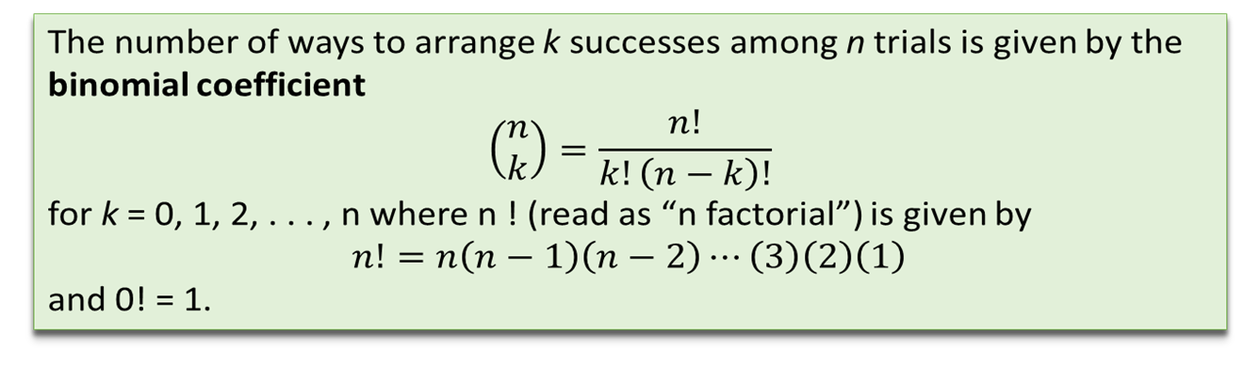
Calculating Binomial Probabilities

Slide 24
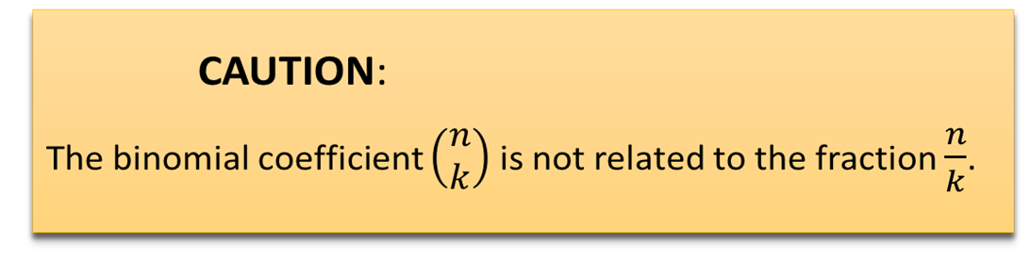

Calculating Binomial Probabilities

Slide 25
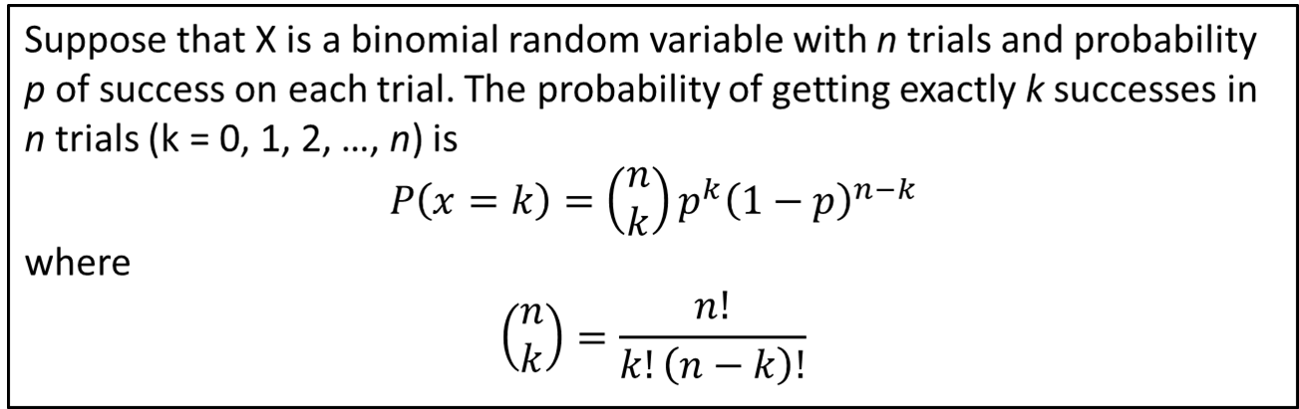
Calculating Binomial Probabilities
Binomial Probability Formula

Slide 26
Calculating Binomial Probabilities
Problem: Genetics says that the genes children receive from their parents are independent from one child to another. Each child of a particular set of parents has probability 0.25 of having type O blood. Suppose these parents have 5 children. Let X = the number of children with type O blood. Find P(X = 3). Interpret this value.

Slide 27
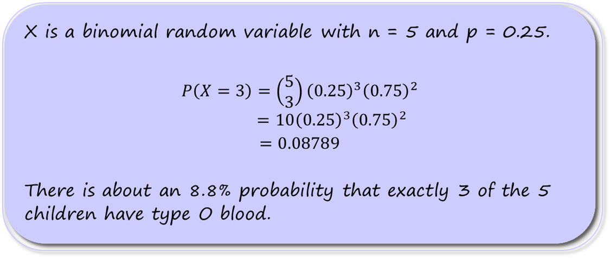
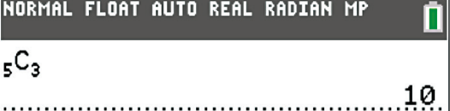
Calculating Binomial Probabilities
Problem: Genetics says that the genes children receive from their parents are independent from one child to another. Each child of a particular set of parents has probability 0.25 of having type O blood. Suppose these parents have 5 children. Let X = the number of children with type O blood. Find P(X = 3). Interpret this value.

Slide 28
Calculating Binomial Probabilities
Problem: The preceding example tells us that each child of a particular set of parents has probability 0.25 of having type O blood. Suppose these parents have 5 children. Should the parents be surprised if more than 3 of their children have type O blood? Calculate an appropriate probability to support your answer.

Slide 29
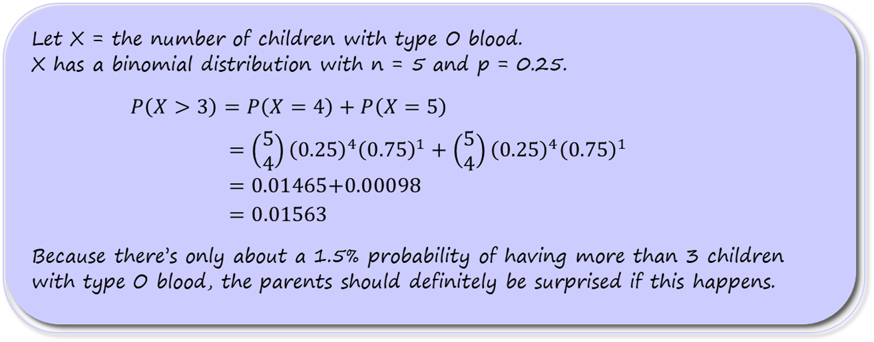
Calculating Binomial Probabilities
Problem: The preceding example tells us that each child of a particular set of parents has probability 0.25 of having type O blood. Suppose these parents have 5 children. Should the parents be surprised if more than 3 of their children have type O blood? Calculate an appropriate probability to support your answer.

Slide 30
Discrete: Multinomial distribution
:A multinomial distribution is the probability distribution of n repeated trials, where each trial can have a number of possible outcomes (k).
P = [ n! / ( n₁! * n₂! * ... n_{k}! ) ] * ( p₁^{n}₁ * p₂^{n}₂ * . . . * p_{k}^{n}_{k} )
where n = n₁ + n₂ + . . . + n_{k}.
A wins n₁ = 3 games with probability p₁ 0.30.
B wins n₂ = 4 games with probability p₁ 0.50.
Match draw n₃ = 3 times with probability 0.20.
dmultinom(x=c(3,4,3), prob = c(0.3,0.5,0.2))
[1] 0.0567

Slide 31
Multinomial Distribution - Motivation
Suppose we modified assumption (1) of the binomial distribution to allow for more than two outcomes.
For example, we might be interested in calculating the following probabilities for the offspring of parents that are heterozygote carriers of a recessive trait.
Q₁: One of their n=3 offspring will be unaffected (AA), 1 will be affected (aa) and one will be a carrier (Aa),
Q₂: All of their offspring will be carriers,
Q₃: Exactly two of their offspring will be affected (aa) and one will be a carrier.

Slide 32
Multinomial Distribution - Motivation
For each child, we can represent each of these possible outcomes with three indicator variables for the i^{th} child as:
Y_{i1} = 1 if i^{th} child is unaffected (AA) & =0 otherwise
Y_{i2} = 1 if i^{th} child is a carrier (Aa) & =0 otherwise
Y_{i3} = 1 if i^{th} child is affected (aa) & =0 otherwise
Notice only one of the three Y_{i1}, Y_{i2}, Y_{i3} can be equal to 1 (Y_{i1} +Y_{i2}+Y_{i3}= 1).
For the binomial distribution with 2 outcomes (e.g., unaffected vs. carrier/affected), there are 2^{n} unique outcomes in n trials. In the family with n=3 children, there are 2³ = 8 unique outcomes.
For the multinomial distribution with 3 outcomes, the number of unique outcomes in n trials is 3^{n}. For the family of 3, that’s 3³=27 unique outcomes.

Slide 33
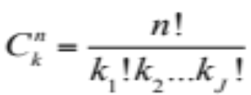
Possible Outcomes
Combinations: As with the binomial distribution, when order doesn’t matter, the total number of possible outcomes, can be straightforwardly calculated. For the multinomial distribution, the combinations are calculated as
where the k_{j} (j=1, 2,…, J) correspond to the totals for the different outcomes.
e.g. n=2 children
J=3 possible outcomes (unaffected/carrier/affected)
Child number
1 2 Outcomes
AA AA 2 unaffected, 0 carrier, 0 affected
AA Aa 1 unaffected, 1 carrier, 0 affected
Aa AA 1 unaffected, 1 carrier, 0 affected
AA aa 1 unaffected, 0 carrier, 1 affected
aa AA 1 unaffected, 0 carrier, 1 affected
Aa Aa 0 unaffected, 2 carrier, 0 affected
aa Aa 0 unaffected, 1 carrier, 1 affected
Aa aa 0 unaffected, 1 carrier, 1 affected
aa aa 0 unaffected, 0 carrier, 2 affected
Module 1, Session 3

Slide 34

For n=2 children, what are the probabilities of various outcomes?
E.g. (n=2, k₁=number of unaffected, k₂=number of carrier, k₃=number of affected)
Child number
1 2 Outcomes # ways
p₁ p₁ k₁=2,k₂=0,k₃=0 1
p₁ p₂ k₁=1,k₂=1,k₃=0 2
p₂ p₁ k₁=1,k₂=1,k₃=0
p₁ p₃ k₁=1,k₂=0,k₃=1 2
p₃ p₁ k₁=1,k₂=0,k₃=1
p₂ p₂ k₁=0,k₂=2,k₃=0 1
p₃ p₂ k₁=0,k₂=1,k₃=1 2
p₂ p₃ k₁=0,k₂=1,k₃=1
p₃ p₃ k₁=0,k₂=0,k₃=2 1
For each possible outcome, the probability Pr[Y₁=k₁, Y₂=k₂, Y₃=k₃] is p₁^{k1}p₂^{k2}p₃^{k3}
There are sequences for each probability, so in general…

Slide 35
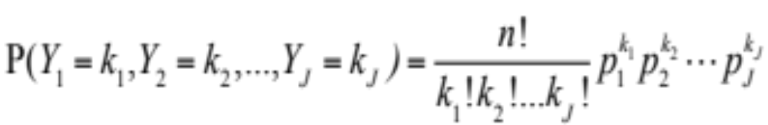
Multinomial Probabilities
The probability that a multinomial random variable with n trials and success probabilities p₁, p₂, …, p_{J} will yield exactly k₁, k₂,…k_{J} successes is:
Assumptions:
1) J possible outcomes – only one of which can be a success (1) a given trial.
2) The probability of success for each possible outcome, p_{j}, is the same from trial to trial.
3) The outcome of one trial has no influence on other trials (independent trials).
4) Interest is in the (sum) total number of “successes” over all the trials.
k₁ k₂ k₃ k₄
k_{J-1} k_{J}

Slide 36
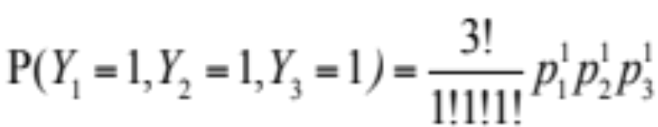
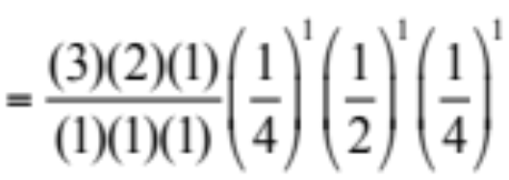
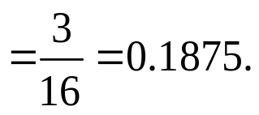
Multinomial Probabilities - Examples
Returning to the original questions:
Q₁: One of n=3 offspring will be unaffected (AA), one will be affected (aa) and one will be a carrier (Aa) (recessive trait, carrier parents)?
Solution: For a given child, the probabilities of the three outcomes are:
  p₁ = Pr[AA] = 1/4
  p₂ = Pr[Aa] = 1/2
  p₃ = Pr[aa] = 1/4
We have

Slide 37
Questions 1, 2
Recall, carrier=Aa with Pr(Aa) = ½
unaffected=AA with Pr(AA) = ¼
affected=aa with Pr(aa) = ¼
What is the probability that all three offspring will be carriers?
What is the probability that exactly two offspring will be affected and one a carrier?

Slide 38
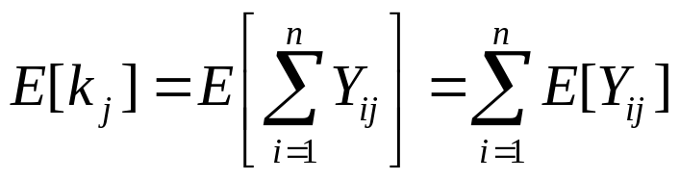
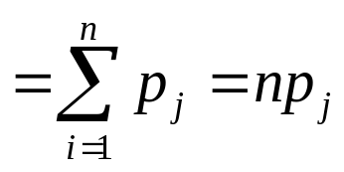
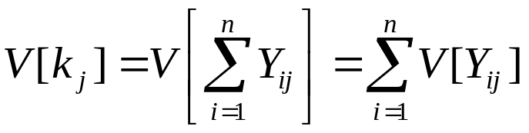
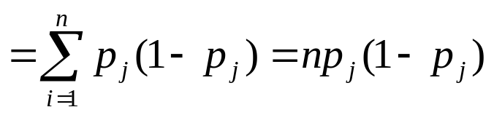
Example - Mean and Variance
The (marginal) outcomes of the multinomial distribution are binomial. We can immediately obtain the means for each outcome, e.g, Y_{j} = k_{j}, the j^{th} outcome:
Mean:
Variance:

Slide 39
Multinomial Distribution Summary
1. Multinomial RVs are discrete
2. Parameters - n, p₁, p₂,…,p_{J}
Each outcome Y_{j} = k_{j} is the sum of n independent Bernoulli outcomes
Extends binomial distribution
5. Contingency tables, polytomous regression

Slide 40
Continuous Distributions

Slide 41
Continuous Distributions
For measurements like height and weight which can be measured with arbitrary precision, it does not make sense to talk about the probability of any single value. Instead we talk about the probability for an interval.
P[weight = 70.000kg] ≈ 0
P[69.0kg < weight < 71.0kg] = 0.08
For discrete random variables, we had a probability mass function to give us the probability of each possible value. For continuous random variables we use a probability density function to tell us about the probability of obtaining a value within some interval.

Slide 42
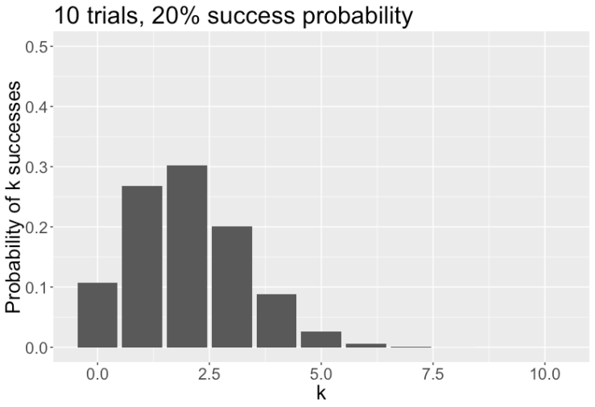
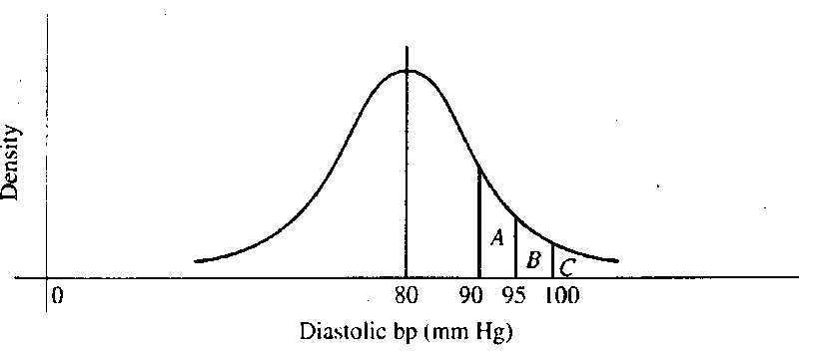
With discrete probability distributions, we can determine the probability of a single outcome, e.g.:
With continuous probability distributions, we can determine the probability across a range of outcomes:
For any interval, the area under the curve represents the probability of obtaining a value in that interval.

Slide 43

Probability density function
1. A function, typically denoted f(x), that gives probabilities based on the area under the curve.
2. f(x) ≥ 0
3. Total area under the function f(x) is 1.
Cumulative distribution function
The cumulative distribution function, F(t), tells us the total probability that X is less than some value t.
F(t) = P(X ≤ t)

Slide 44
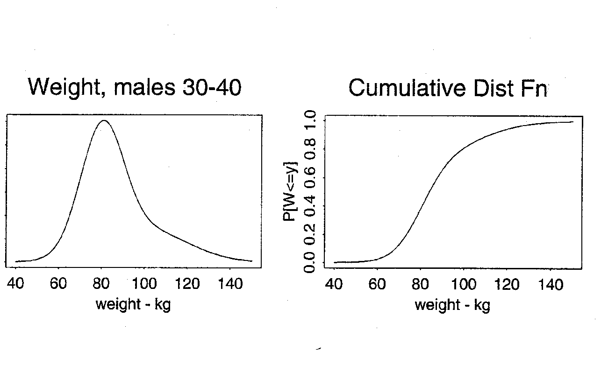
f(t)
F(t)
Prob[weight < 80] = 0.40
Area under the curve

Slide 45
Normal Distribution
A well-known probability model for continuous data
Bell-shaped curve
takes values between -∞ and + ∞
symmetric about mean
mean = median = mode
Common examples (that don’t always hold):
  birthweights
  blood pressure
  CD4 T cell counts (transformed)
The normal distribution is more useful
as a derived distribution,
as we will see when we talk about the
central limit theorem.

Slide 46
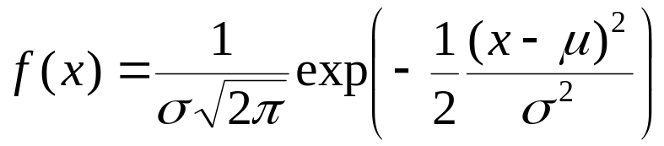
Normal Distribution
Specifying the mean and variance of a normal distribution completely determines the probability distribution function and, therefore, all probabilities.
The normal probability density function is:
where
π ≈ 3.14 (a constant)
Notice that the normal distribution has two parameters:
μ = the mean of X
σ = the standard deviation of X
We write X~N(μ , σ²).
The standard normal distribution, N(0, 1), is a special case where μ = 0 and σ² = 1.

Slide 47
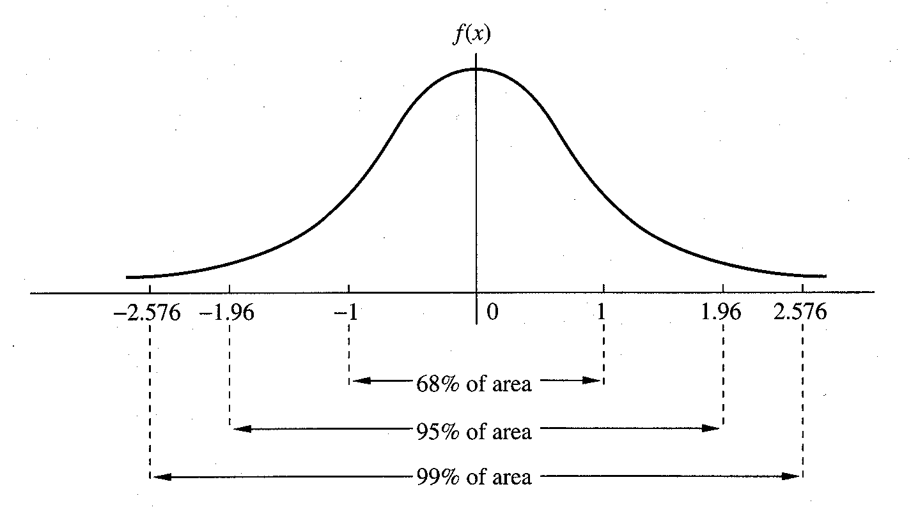

Slide 48
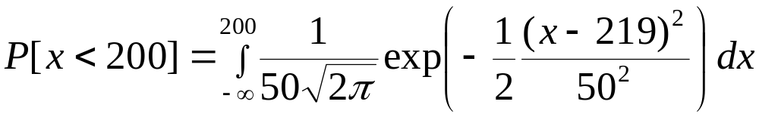
Normal Distribution - Calculating Probabilities
Example
Serum cholesterol is approximately normally distributed with mean 219 mg/mL and standard deviation 50 mg/mL. If the clinically desirable range is < 200 mg/mL, then what proportion of the population falls in this range?
X = serum cholesterol in an individual.
μ = 219 mg/mL
σ = 50mg/mL
negative values for cholesterol ??

Slide 49
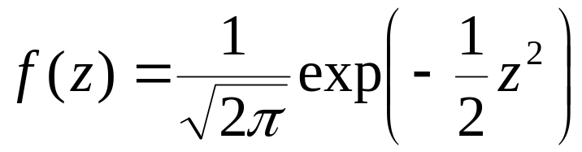
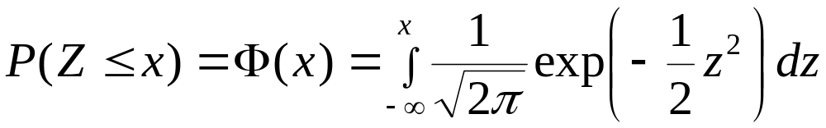
Standard Normal Distribution - Calculating Probabilities
First, let’s consider the standard normal - N(0,1). We will usually use Z to denote a random variable with a standard normal distribution. The probability density function of Z is:
and the cumulative distribution of Z is:
Any computing software can give you the values of f(z) and Φ(z)

Slide 50
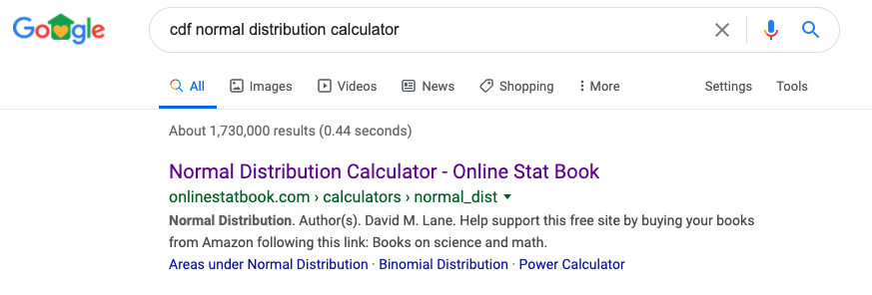
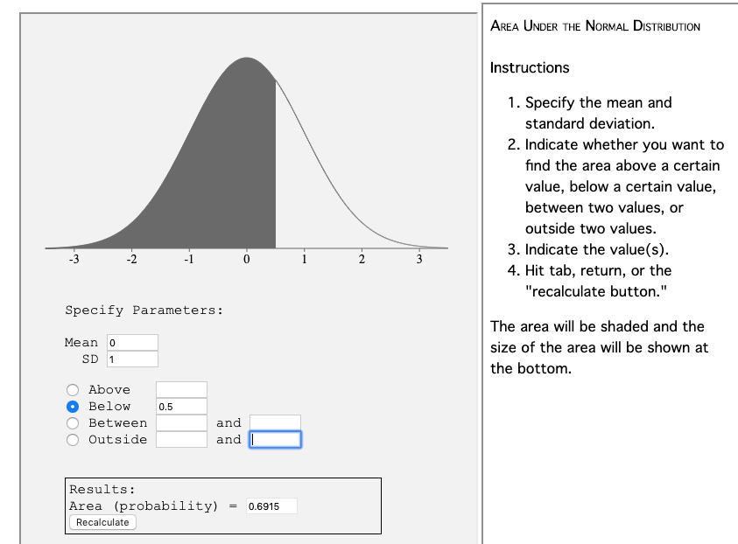
Standard Normal Distribution - Calculating Probabilities
Pr(Z ≤ 0.5) = 0.6915

Slide 51
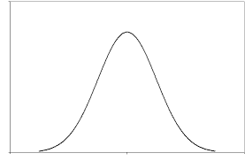
Facts about probability distributions
P(Z ≤ z) = a
P(Z > z) = 1- a
P(Z ≤ x) = b, P(Z ≤ y) = c
Pr(x < Z ≤ y ) = c - b
a
1-a
z
c
b
c-b
x
y

Slide 52
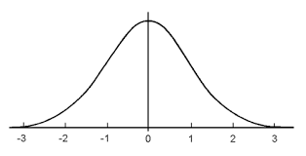
Facts about the standard normal distribution
Because the N(0,1) distribution is symmetric around 0,
Pr(Z ≤ -y) = Pr(Z ≥ y) = d
d
d
-y
y

Slide 53
Questions 3, 4, 5, 6
Google “cdf normal distribution calculator” and find the following if Z ~ N(0,1)
3. P(Z ≤ 1.65) =
4. P(Z ≥ 0.5) =
5. P(-1.96 ≤ Z ≤ 1.96) =
6. P(-0.5 ≤ Z ≤ 2.0) =

Slide 54
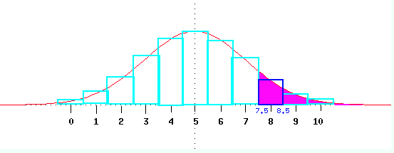
Normal Approximation to Binomial Distribution
Binomial
  When np(1-p) is “large” (e.g. ≥ 3), the normal distribution may be used to approximate the binomial distribution.
  X ~ bin(n,p)
    E(X) = np
    V(X) = np(1-p)
  X is approximately N(np, np(1-p))
  Apply continuity correction for discreteness:
    P(X ≤ x) is a discrete binomial so to calculate it from a continuous normal, use P(X ≤ x + 0.5)
http://www.cs.uni.edu/~campbell/stat/prob9.html

Slide 55
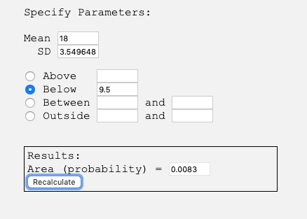
Application of Normal Approximation to Binomial Distribution
Example:
Suppose the prevalence of HPV in women 18 -22 years old is 30%. What is the probability that in a sample of 60 women from this population that 9 or less would be infected?
Solution
X = number infected out of 60
X ~ Binomial(n=60, p =0.3)
X close to Normal distribution with mean 60*0.3=18 and variance 60*0.3*(1-0.3)=12.6
Therefore, P(X ≤ 9.5) = 0.0083
Summer Institutes 2020
Module 1, Session 3

Slide 56
Discrete: Poisson distribution
A Poisson distribution is the probability distribution that finds the probability of events based on average past probability.
P(x; μ) = (e^{-μ}) (μ^{x}) / x!
where e = 2.71828.
Suppose the average number of cars sold by a company is five per day. We can find out the probability that six cars will be sold tomorrow
> ppois(6, lambda=5)
[1] 0.7621835

Slide 57
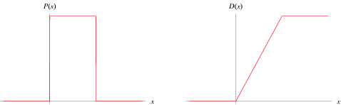
Continuous uniform distribution
takes continuous uniform values over a range. It can be rectangular or constant (saturated) after some values of x.

Slide 58

Exponential distribution
Exponential distribution is described for randomly recurring events. If the average time of the recurring event is μ,thenexponential distribution calculates the probability of the recurrence of the next event. Its PDF is defined as follows

Slide 59
Exponential Distribution
      Let us assume that the mean check-out time of a cash counter is 5 minutes. We can find out the probability that a customer check-out will be completed by the cashier in <=3 minutes, as follows:
Check-out rate = 1/5
X = 3
> pexp(3, rate=1/5)
[1] 0.4511884

Slide 60
Hypothesis Test
A statistical hypothesis test is a method of statistical inference used to decide whether the data at hand sufficiently support a particular hypothesis. Hypothesis testing allows us to make probabilistic statements about population parameters.

Slide 61
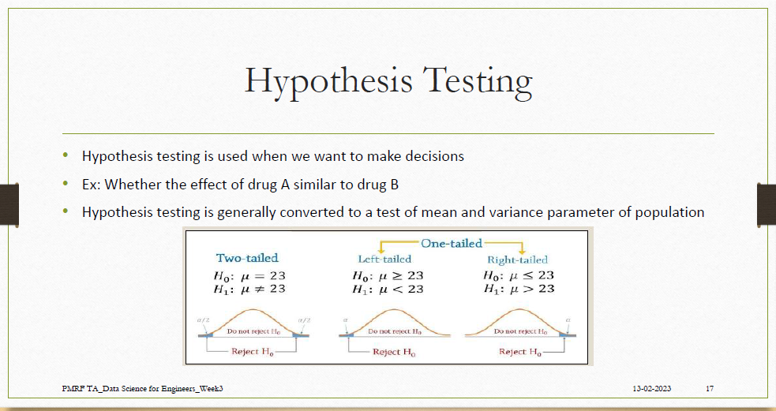

Slide 62
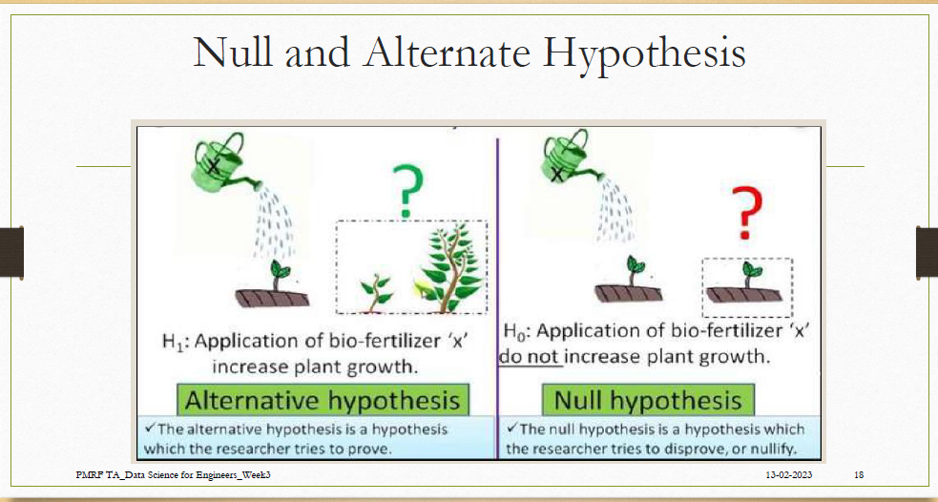

Slide 63
Confidence Interval
a confidence interval (CI) is a range of estimates for an unknown parameter.
A confidence interval is computed at a designated confidence level;
Example: the 95% confidence level is most common, but other levels, such as 90% or 99%, are sometimes used
The confidence level represents the long-run proportion of Cis that theoretically contain the true value of the parameter.
For example, out of all intervals computed at the 95% level, 95% of them should contain the parameter's true value.

Slide 64
Sampling Distributions
Sampling distribution
Central Limit Theorem
Chi-squared distribution
Student’s t distribution
F distribution

Slide 65
Sampling distribution
In statistics, very often data from the entire population cannot be collected and used for analysis or training. We need to select samples that would represent the entire population.
So we can use the probability distribution of sample statistics.
The sample drawn from a population having a specific probability distribution is called sampling distribution
the parameters of the sampling distribution
Mean X̄ = μ
Variance S² = σ2/n

Slide 66
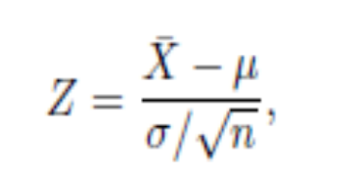
Central Limit Theorem
According to this theorem, the average of the sample mean and standard deviation of a sample of large size is equal to the population mean and standard deviation.
where X̄ is the mean of a random sample of size n; μ is the mean of the population and σ2 is the variance of the population.

Slide 67
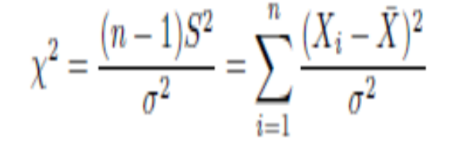
Sampling Distribution of χ2
the variability in mean values in the Central Limit Theorem and learned that the larger the size of the sample, the more the distribution tends to standard normal distribution.
In a sampling distribution of χ2,variability needs to be considered.
The chi-squared distribution with v = n − 1 degrees of freedom is given by

Slide 68
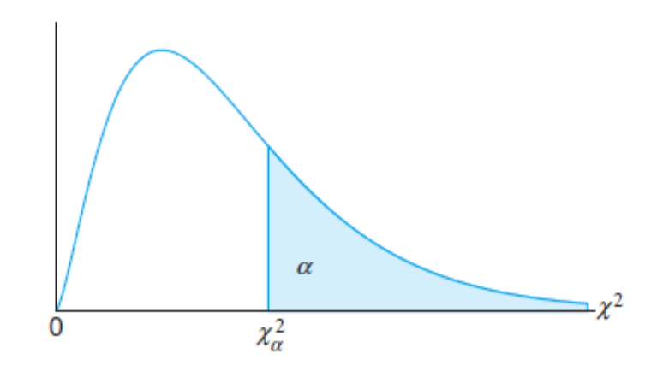
To calculate the probability that a random sample produces a chi-squared distribution value greater than χ2_{α}

Slide 69
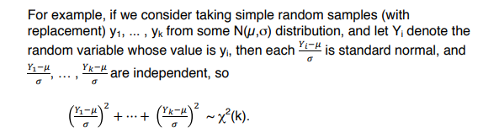

Slide 70
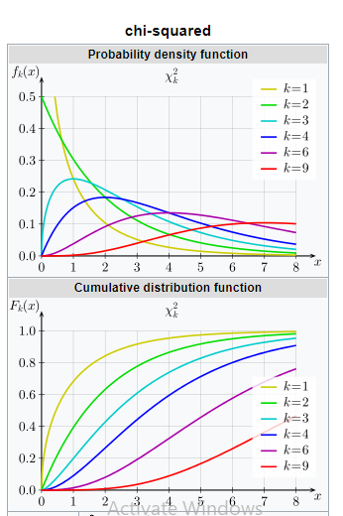

Slide 71
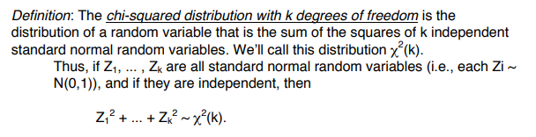
Chi-squared distribution
As an example, what would be the 86th percentile of the chi-squared distribution, if the degree of freedom is 6?
We can use the qchisq() function in R, with the percentile passed as .86.
> qchisq(.86, df=6)
[1] 9.65399

Slide 72

Student’s t distribution
where z is the same as in a standard normal distribution, V is the chi-squared distribution and m is the degree of freedom.
For example, to find the 12th and 88th percentiles of a student t distribution with degree of freedom = 7, we can use the R function qt(), and pass .12 as the value for Z and .88 for V.
> qt(c(.12, .88), df=7)
[1] -1.284014 1.284014

Slide 73
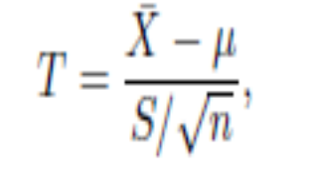
Student’s t Distribution
Student’s t distribution is used to estimate the significance of the values.
It is used when you want to estimate the mean in a normally distributed population of small size where the standard deviation of the population is not known.
where x̄ is the sample mean; μ is the population mean; S represents the sample standard deviation; and N represents the degree of freedom.

Slide 74
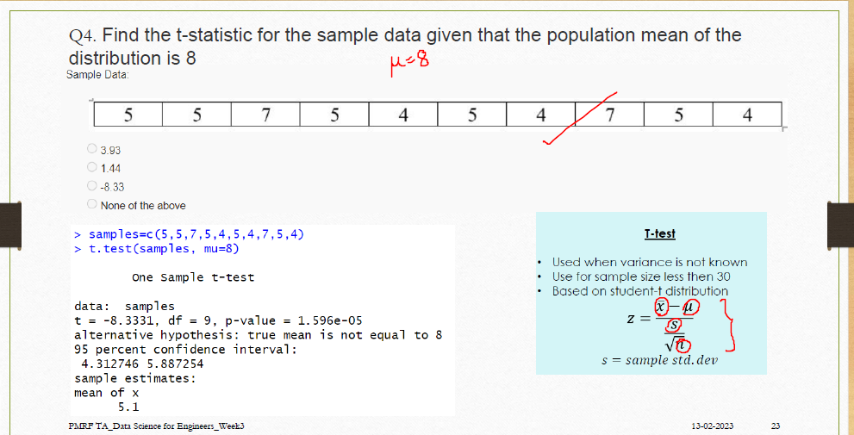

Slide 75
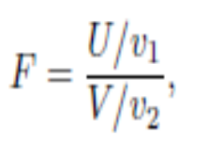
F Distribution
It is used to test whether two samples have the same variance. A chi-ssquared distribution deals with one variable and one degree of freedom, but F distribution deals with multiple variables and multiple degrees of freedom.
If U has an χ2 distribution with v1 degree of freedom and V has an χ2 distribution with v2 degree of freedom, F distribution is defined as

Slide 76
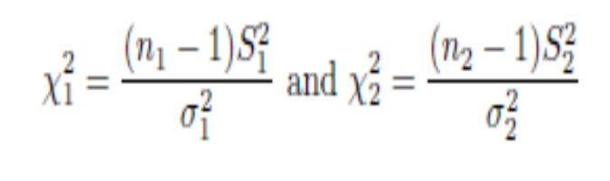
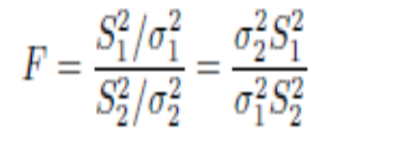
F Distribution
If the variance of two samples is S₁ and S₂ and the population variance is σ²₁ and σ²₂, the chi- squared distribution with n₁ and n₂ degrees of freedom is defined as

Slide 77

F distribution
F distribution is defined on two independent random variables having chi-squared distribution.
where V1 and V2 are two independent random variables and m1 and m2 represent the degree of freedom.
      To find out the F distribution of the 88th percentile, with degree of freedom as 7, 3, we can use the qf() function in R:
      > qf(.88, df1=7, df2=3)
      [1] 4.559049

Slide 78
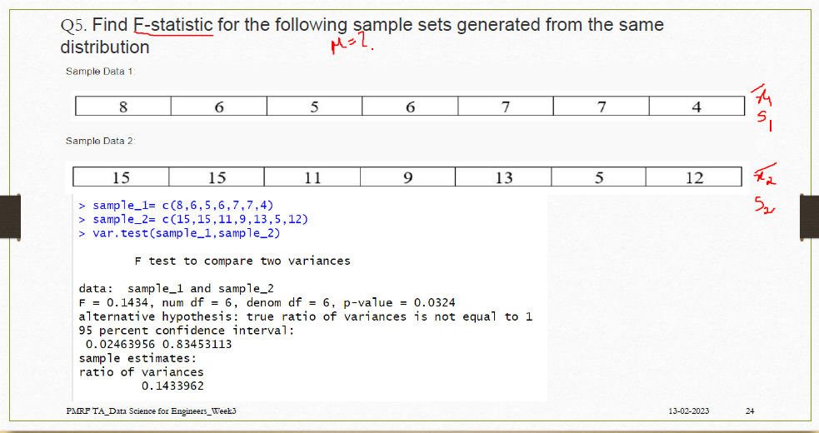

Slide 79
Summary
Samples drawn from population having a specific probability distribution is called sampling distribution.
The sampling distribution of a statistics depends on , the size of the population, the size of the samples and the method of choosing the samples.
The Central Limit Theorem states that average of the sample mean and deviations of large size sample is equal to population mean and standard deviation.
The chi-square distribution relation between variations in sampling distribution of size n and population variance σ2
The t distribution is a probability distribution that is used to estimate population parameters when the sample size is small and when the population variance is unknown.
F-distribution is related to χ2 distribution. It is to test whether the two samples have same variance or not.

Slide 80
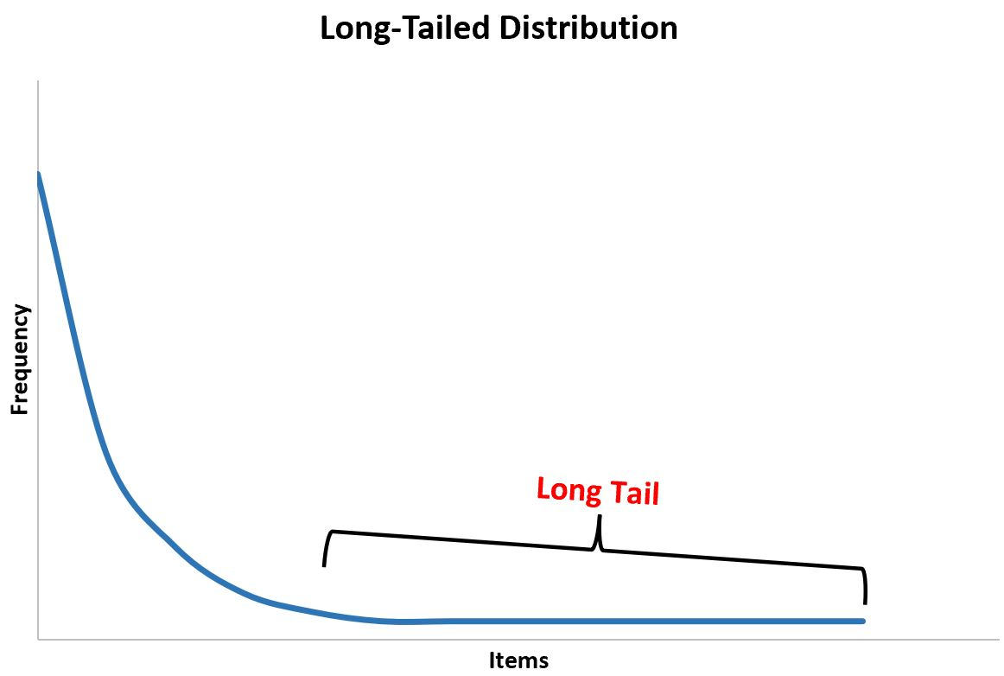
Long Tail Distribution
a long tail distribution is a distribution that has a long “tail” that slowly tapers off toward the end of the distribution.

Slide 81
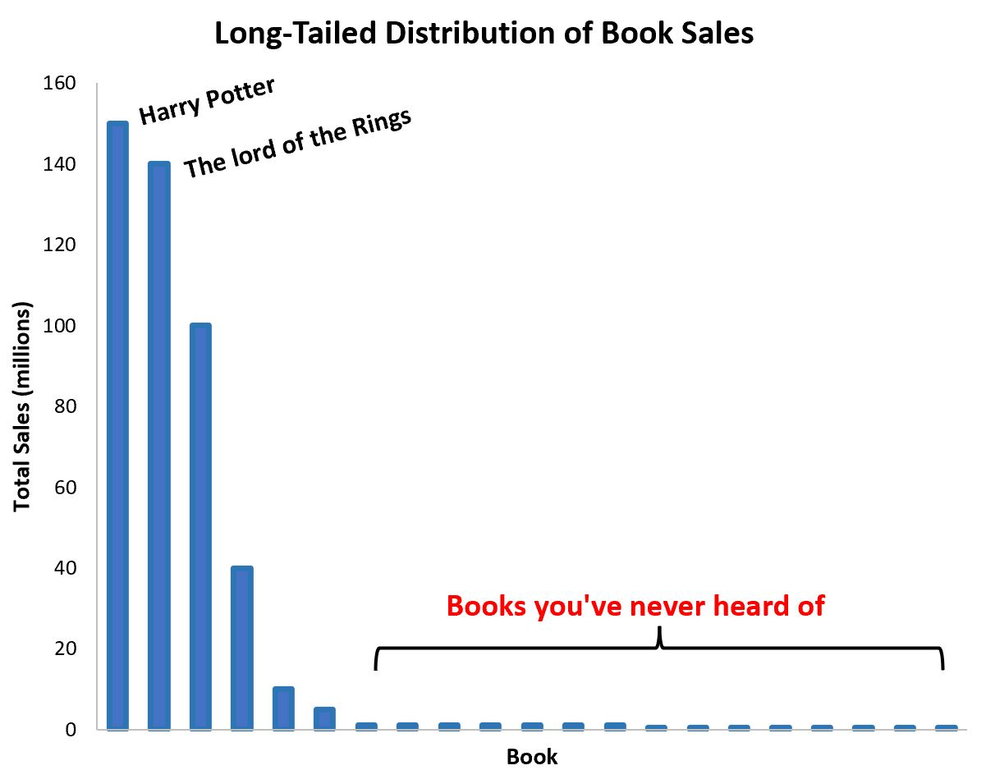

Slide 82
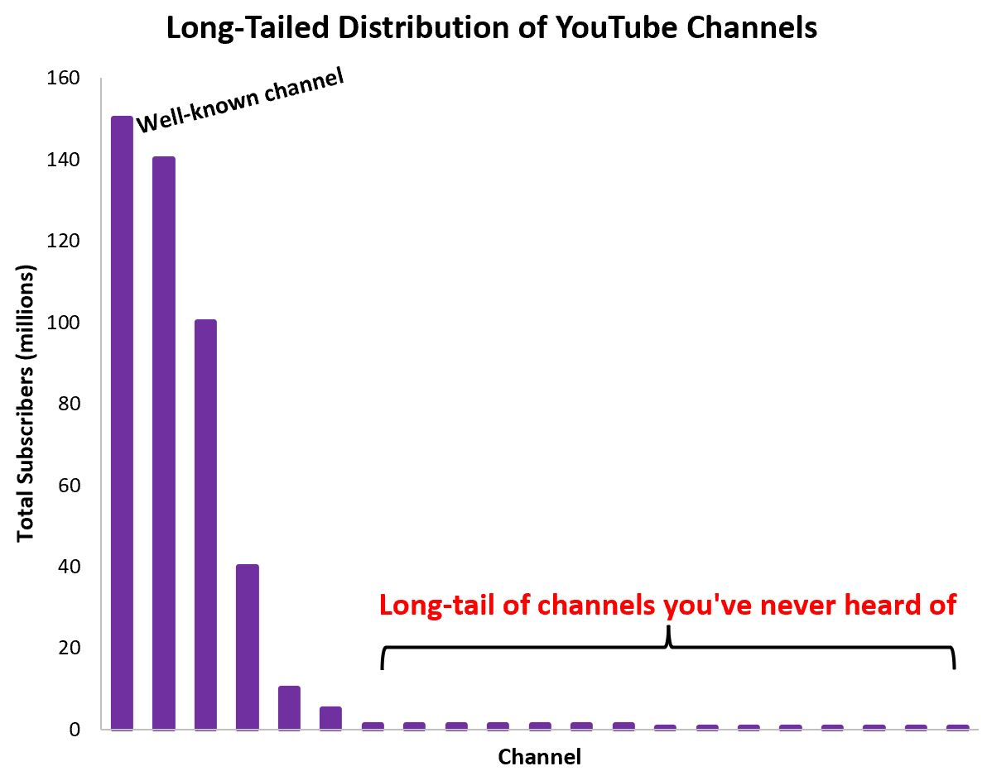
Long-tail distributions are particularly important to understand in business because they present an opportunity for a business model that revolves around making a few sales for a lot of products.

Slide 83
What is a Bootstrap
A method of Resampling: creating many samples from a single sample
Generally, resampling is done with replacement
Used to develop a sampling distribution of statistics such as mean, median, proportion, others.

Slide 84
Boot Strap
The key to the bootstrap is the view of the relationship of the sample to the population
We take a sample from the population and infer something about a population parameter using a statistic T (e.g. mean, median, variance)
We use knowledge of the sampling distribution of T to assess its accuracy (std error, confidence interval, etc.)
We want the sampling distribution of T without making unreasonable assumptions (e.g. normality) about the populations

Slide 85
Bootstrap population
The bootstrap posits a population that replicates the sample
To sample from the bootstrap population, sample WITH replacement from the sample (aka ‘resample’)
Recompute the statistic T for these bootstrap samples to learn about the sampling distribution of T

Slide 86
Bootstrap samples
Suppose the sample from the population were Matthew, Mark, Luke, John, Paul, George, and Ringo (n=7)
Then bootstrap samples of size 7 would be taken WITH replacement, so one could be (Mark, Mark, John, Paul, Paul, Paul, Ringo) or (Matthew, Luke, Luke, John, John, Paul, George)

Slide 87
Bootstrap samples with numbers
This is easier with an index, say, 1,2,3,4,5,6,7
Then the two bootstrap samples are just (2,2,4,5,5,5,7) and (1,3,3,4,4,5,6)

Slide 88
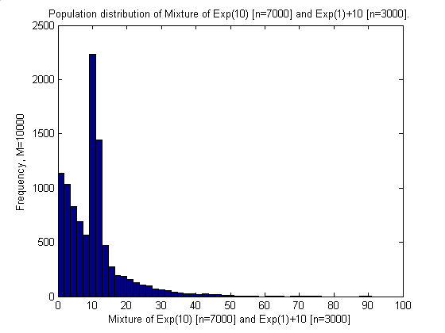
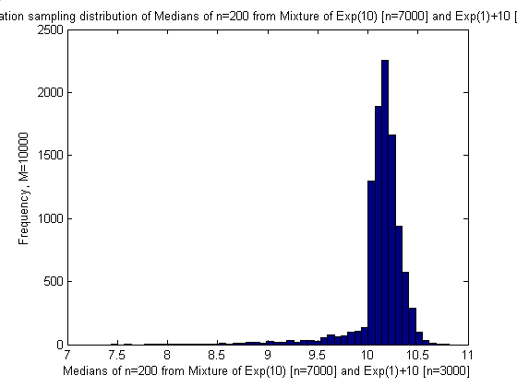
Histograms of Complex Population Distribution

Slide 89



Histograms of Population Sampling Distribution of the Median and Estimated Bootstrap Sampling Distributions

Slide 90
Advantages and Disadvantages
Advantages:
  Avoids the costs of taking new samples (Estimate a sampling distribution when only one sample is available)
  Checking parametric assumptions
  Used when parametric assumptions cannot be made or are very complicated
  Estimation of variance in quantiles
Disadvantages:
  Relies on a representative sample
  Variability due to finite replications

Slide 91
Selection bias is a general term describing errors arising from factors related to the population being studied,
there are several types of selection bias: Sampling bias or ascertainment bias occurs when some members of the intended population are less likely to be included than others

